Slide 1
INSTANT (SCAR) Programme
Theme 1: Atmosphere-ocean-ice interactions Subcommittee 3: Southern Ocean- Antarctic chronology and environmental proxies (SOACEP)
Georgia R. Grant, GNS Science (New Zealand)
Sedimentologist, paleoclimatologist, CONOP
Laura De Santis, OGS (Italy)
Seismic stratigraphy, geophysics, Co-Chief IODP Exp. 374
JL Andersen S Berg M Bentley P Bijl S Boharty C Buizert L Capotondi M Casado D Chandler X Crosta C Escuita J Etorneau CD Hillenbrand X Huang M Iwai K Johnson RS Jones D Kulhanek L Lembke-Jene K Licht E McClymont R McKay P Montagna C Morigi F Nitsche T Noble P O'Brien C Ohneiser S Passchier MO Patterson E Pearson L F. Pérez S Roberts A Rovere F Sangiorgi I Sauermilch Y Suganuma N Sullivan R Venturelli
Met on the 12th October to organise workstreams – Next SC meeting March 2022
Aim to have two co-chairs, 8 workstream leaders, Steering group: 37, Additional members: 18
https://app.mural.co/t/gnslara0192/m/gnslara0192/1633233113201/e35f59efecd5683a0233a600f43ba495e7045ad9?sender=ggrant5238

Slide 2
Environmental Proxies Current leads: Dave Chandler, Marie Cavite, Mathieu Casado, Taryn Noble Aim Identifying key regions around antarctica, and gaps of knowledge for proxy development and improvements, with consultation of both proxy and modelling community. Aim Compiling (in interactive format) and analysing paleo proxies used to reconstruct environmental variability throughout the geological past.
 | 2022 | 2023 | 2024 | 2025 | 2026
Purpose | WS 1. Identify the paleo-proxies and critical regions needed by modelers to answer the key science questions. WS 1. Define the gaps in geographical areas, time periods, and proxy understanding. |  | WS 2. Utilise the WS 1. outputs to improve the accuracy of existing proxies through documentation. |  | Years 4 onward - Contribute to collaborative environmental reconstruction and Drive research areas and develop new precise proxies in regards to needs from modelers, new proxies and regions or time periods lacking.
Output | WS 1. “Most wanted” list for proxy records WS 1. Generate interactive location map of available proxy data WS. 1 “Starter kit” webpage for ECRs and cross-disciplinary researchers |  | WS 2. Antarctic-specific review paper: existing and new paleoproxies standardisation of datasets, protocols for proxy measurements and reporting of analytical results, sample and data collections.
Collaboration | INSTANT: Kat Ritz; Stew Jameson – link to modelling community | OceaNice, PlioVar, Quantarctica, DINOSTRAT | ICEPRO, PAGES,

Slide 3
Chronology and correlation Current leads: TBD .
Chronology and Correlation Current leads: TBD AIM Documenting chronological methodology and developing systematic assessment of age models for paleo records.
AIM Improve the correlation at a continental scale between terrestrial and proximal marine, to deep marine southern ocean environmental response through time.
 | 2022 | 2023 | 2024 | 2025 | 2026
Purpose | WS 3. Identify use of dating and correlation methodologies and uncertainties |  | WS 4. Investigate a framework to collate all chronostratigraphic (sediment and ice) records for open access. |  | Years 4 onward – Applying chronostratigraphic framework to paleo records for ice-sediment-ocean correlation. Identify leads and lags in feedbacks, dynamic / abrupt systems.
 |  | WS 3. Determine ‘best-practice’ for developing age models
Output | WS 3. Review paper of current methodologies, constraints and uncertainty analysis. Methodology paper of ‘best-practice’ for developing integrated age models. |  | WS 4. Provide an independent framework for correlating paleo-environmental proxies
Collaboration

Slide 4
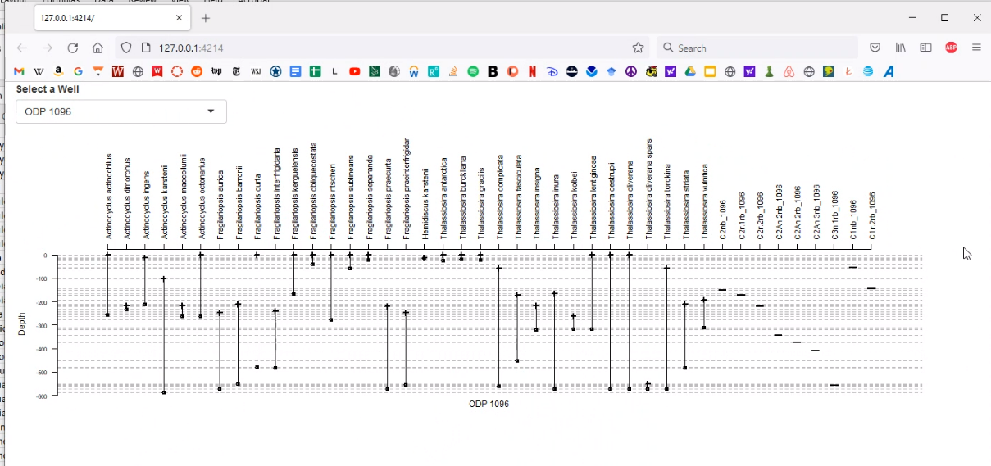
CONOP (Constrained Optimization)

